Slide 1


Android Lecture #8
ListView

Slide 2


목차
Selection Widget
ListView

Slide 3

1. Selection Widget
Selection Widget
Selection Widget

Slide 4

1. Selection Widget
Selection Widget
Data
Data Adaptor
Selection Widget
getView()
Item #0
Item #1
Item #2
Select Item
Adaptor manage data

Slide 5
1. Selection Widget
Making Selection Widget Process
속성 | 설명
Item xml | 리스트 뷰에 들어갈 아이템의 레이아웃을 정의한다.
Item View | 각 아이템을 하나의 뷰로 정의합니다.
Adapter | 데이터 관리 역할을 하는 어댑터 클래스를 만들고, 각 아이템으로 표시할 뷰를 리턴하는 getView() 메소드를 정의합니다.
ListView | 리스트뷰를 만들고 데이터 선택되었을 때 호출될 리스너 객체를 정의합니다.

Slide 6
2. ListView
ListView
ListView

Slide 7
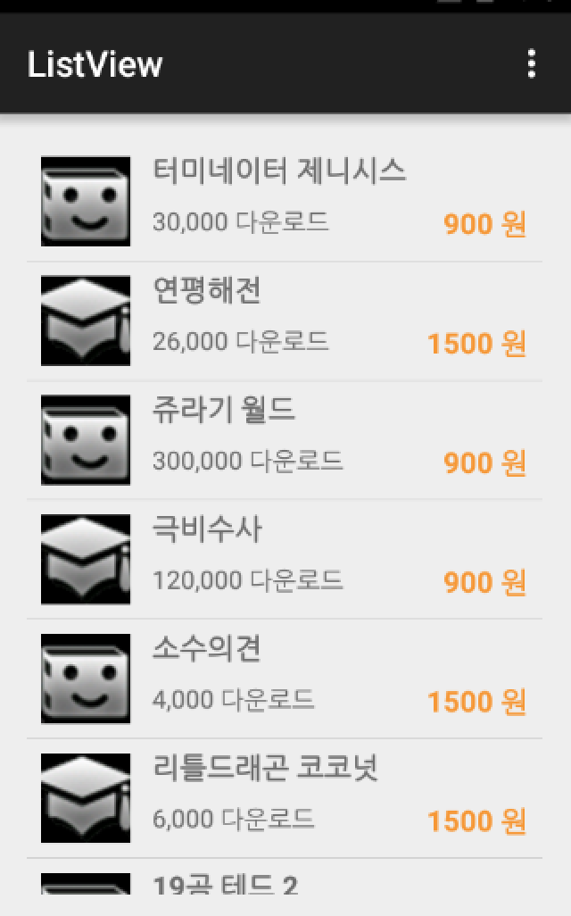
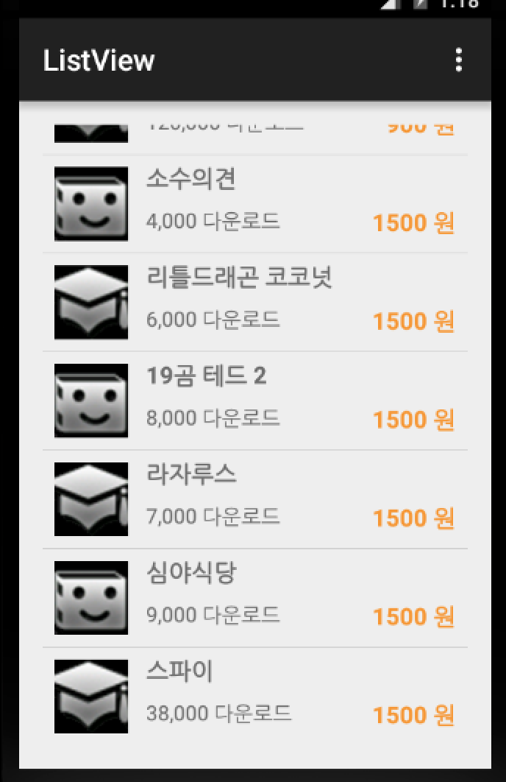
2. ListView
ListView

Slide 8
2. ListView
Item xml
Icon #1
Text #1
Text #2
Text #3

Slide 9
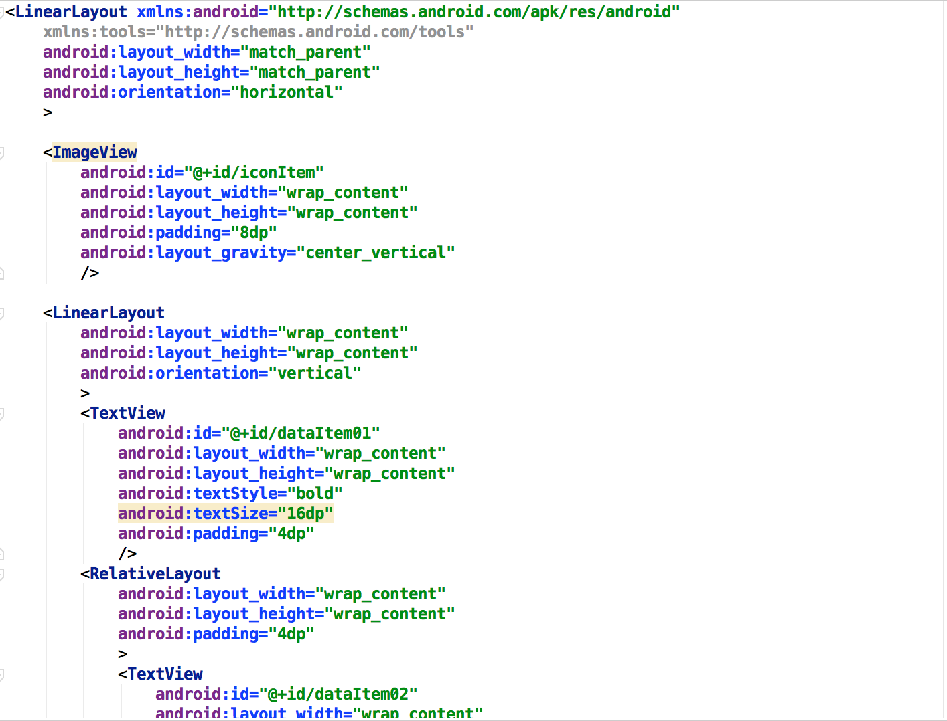
2. ListView
Item xml (listitem.xml)
Image View
Text
View

Slide 10
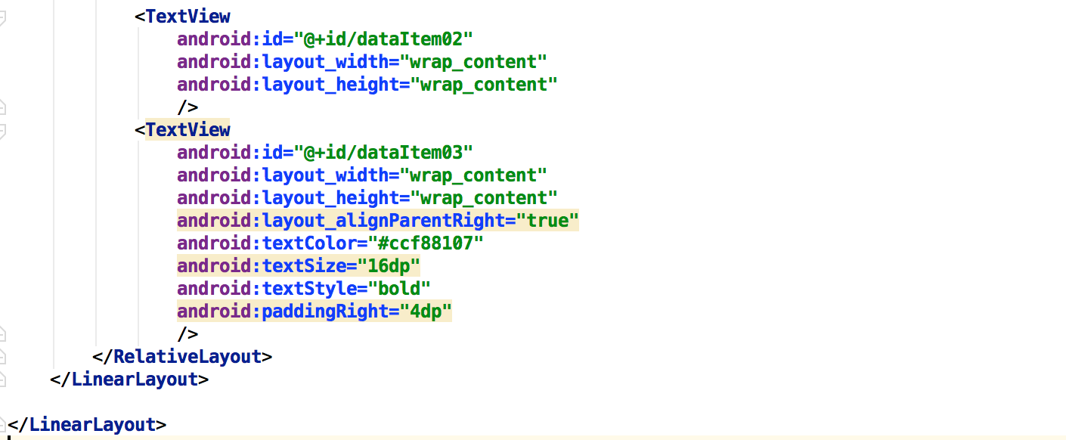
2. ListView
Item xml (listitem.xml)
Text
View

Slide 11
2. ListView
Item xml (listitem.xml)
<LinearLayout xmlns:android="http://schemas.android.com/apk/res/android" xmlns:tools="http://schemas.android.com/tools" android:layout_width="match_parent" android:layout_height="match_parent" android:orientation="horizontal" > <ImageView android:id="@+id/iconItem" android:layout_width="wrap_content" android:layout_height="wrap_content" android:padding="8dp" android:layout_gravity="center_vertical" /> <LinearLayout android:layout_width="wrap_content" android:layout_height="wrap_content" android:orientation="vertical" > <TextView android:id="@+id/dataItem01" android:layout_width="wrap_content" android:layout_height="wrap_content" android:textStyle="bold" android:textSize="16dp" android:padding="4dp" /> <RelativeLayout android:layout_width="wrap_content" android:layout_height="wrap_content" android:padding="4dp" > <TextView android:id="@+id/dataItem02" android:layout_width="wrap_content" android:layout_height="wrap_content" /> <TextView android:id="@+id/dataItem03" android:layout_width="wrap_content" android:layout_height="wrap_content" android:layout_alignParentRight="true" android:textColor="#ccf88107" android:textSize="16dp" android:textStyle="bold" android:paddingRight="4dp" /> </RelativeLayout> </LinearLayout> </LinearLayout>

Slide 12
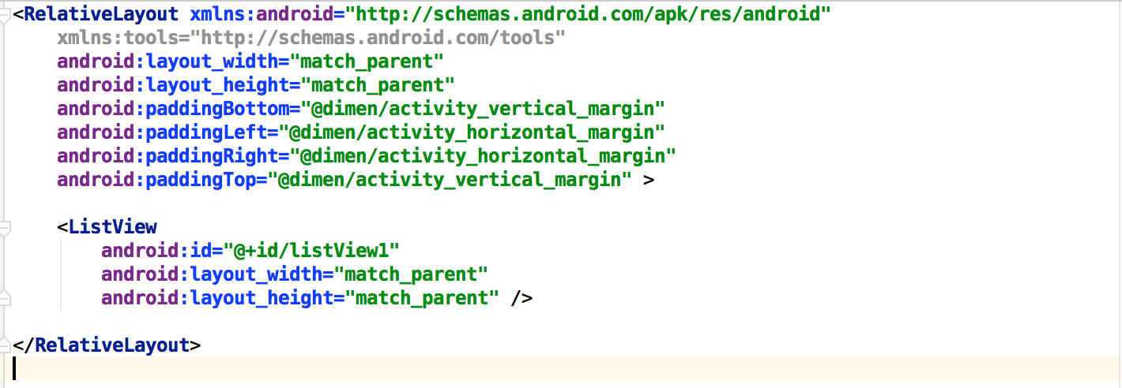
2. ListView
Item xml (actvity_main.xml)

Slide 13
2. ListView
Item xml (actvity_main.xml)
<RelativeLayout xmlns:android="http://schemas.android.com/apk/res/android" xmlns:tools="http://schemas.android.com/tools" android:layout_width="match_parent" android:layout_height="match_parent" android:paddingBottom="@dimen/activity_vertical_margin" android:paddingLeft="@dimen/activity_horizontal_margin" android:paddingRight="@dimen/activity_horizontal_margin" android:paddingTop="@dimen/activity_vertical_margin" > <ListView android:id="@+id/listView1" android:layout_width="match_parent" android:layout_height="match_parent" /> </RelativeLayout>

Slide 14
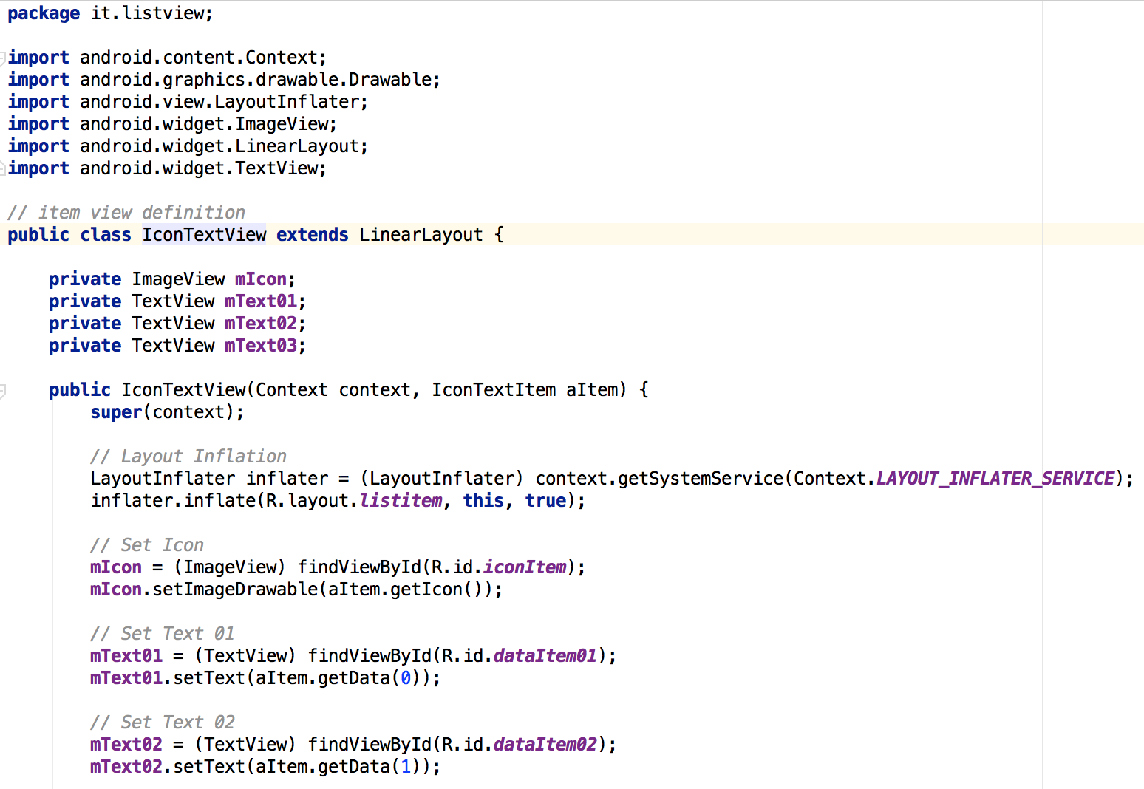
2. ListView
Item View(IconTextView.java)
변수 설정
생성자
메모리 객체화

Slide 15
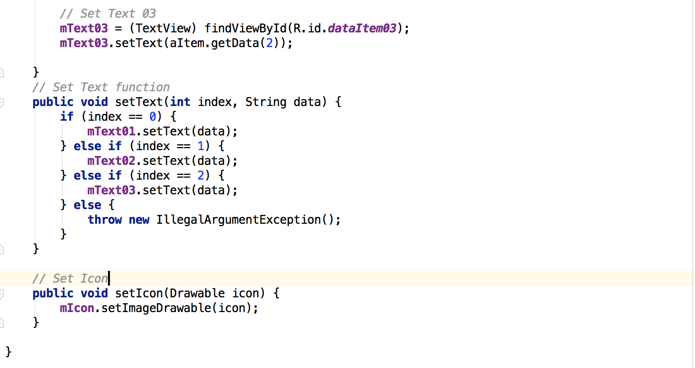
2. ListView
Item View(IconTextView.java)
테이터 텍스트뷰에 설정

Slide 16
2. ListView
Item View(IconTextView.java)
package it.listview; import android.content.Context; import android.graphics.drawable.Drawable; import android.view.LayoutInflater; import android.widget.ImageView; import android.widget.LinearLayout; import android.widget.TextView; // item view definition public class IconTextView extends LinearLayout { private ImageView mIcon; private TextView mText01; private TextView mText02; private TextView mText03; public IconTextView(Context context, IconTextItem aItem) { super(context); // Layout Inflation LayoutInflater inflater = (LayoutInflater) context.getSystemService(Context.LAYOUT_INFLATER_SERVICE); inflater.inflate(R.layout.listitem, this, true); // Set Icon mIcon = (ImageView) findViewById(R.id.iconItem); mIcon.setImageDrawable(aItem.getIcon()); // Set Text 01 mText01 = (TextView) findViewById(R.id.dataItem01); mText01.setText(aItem.getData(0)); // Set Text 02 mText02 = (TextView) findViewById(R.id.dataItem02); mText02.setText(aItem.getData(1)); // Set Text 03 mText03 = (TextView) findViewById(R.id.dataItem03); mText03.setText(aItem.getData(2)); } // Set Text function public void setText(int index, String data) { if (index == 0) { mText01.setText(data); } else if (index == 1) { mText02.setText(data); } else if (index == 2) { mText03.setText(data); } else { throw new IllegalArgumentException(); } } // Set Icon public void setIcon(Drawable icon) { mIcon.setImageDrawable(icon); } }

Slide 17
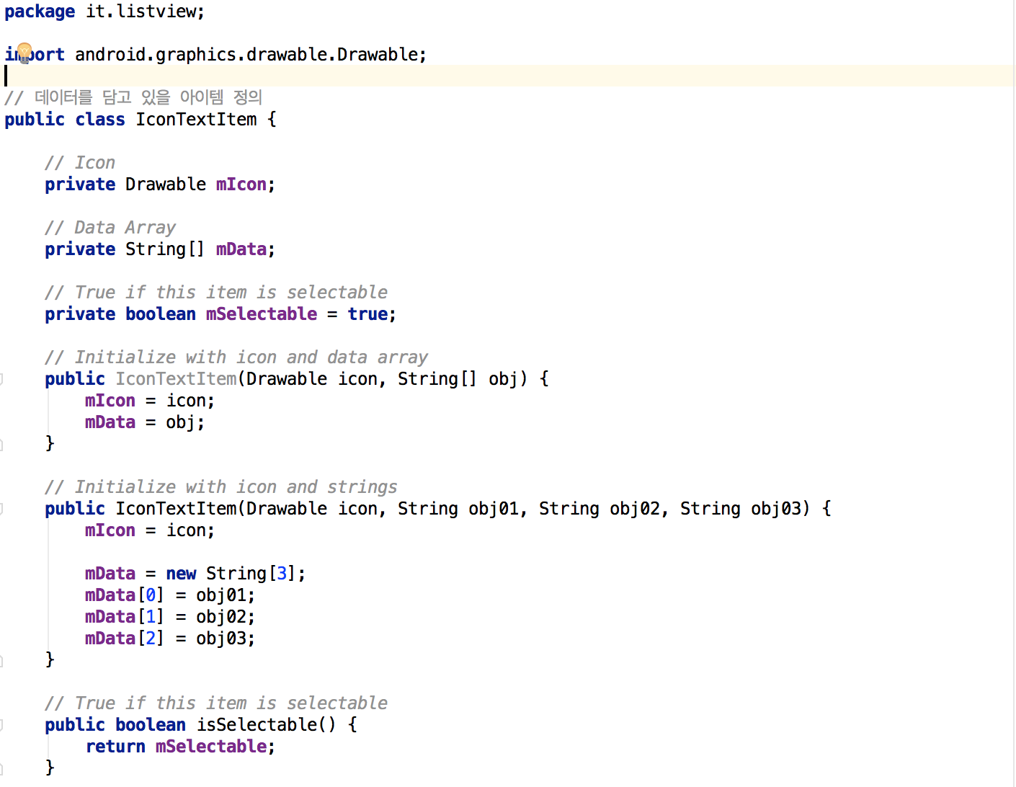
2. ListView
Item Data (IconTextItem.java)
리스트뷰의 한 아이템에 표시할 데이터를 담고 있는 클래스 정의
변수 설정
생성자

Slide 18
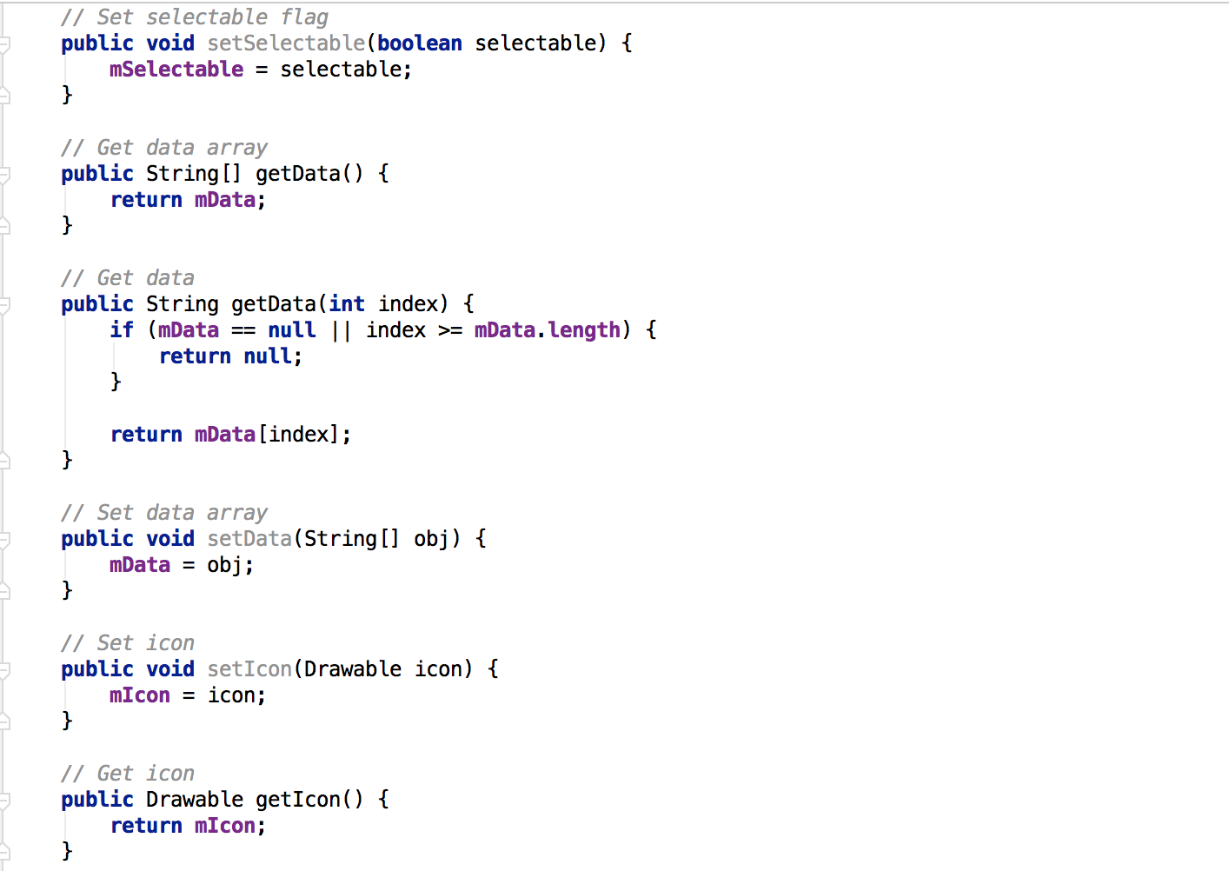
2. ListView
Item Data (IconTextItem.java)
데이터 받는 함수
데이터
설정

Slide 19
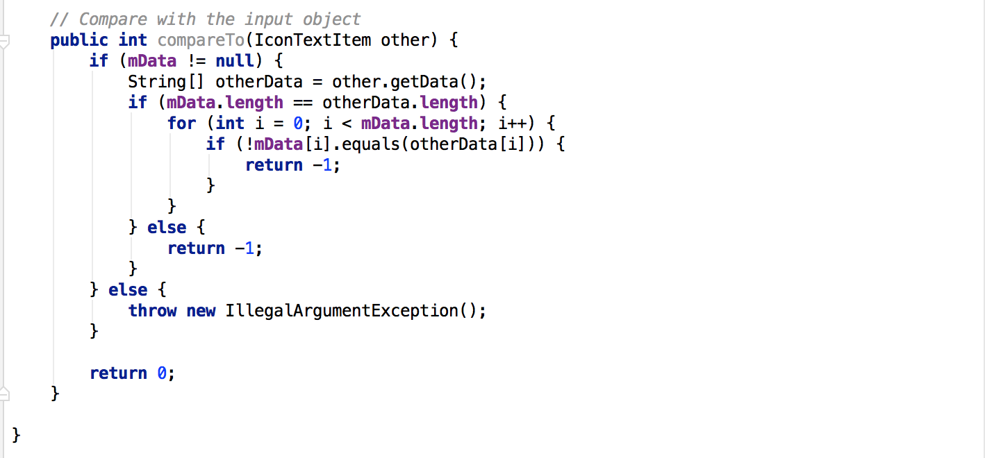
2. ListView
Item Data (IconTextItem.java)

Slide 20
2. ListView
Item Data (IconTextItem.java)
package it.listview; import android.graphics.drawable.Drawable; // 데이터를 담고 있을 아이템 정의 public class IconTextItem { // Icon private Drawable mIcon; // Data Array private String[] mData; // True if this item is selectable private boolean mSelectable = true; // Initialize with icon and data array public IconTextItem(Drawable icon, String[] obj) { mIcon = icon; mData = obj; } // Initialize with icon and strings public IconTextItem(Drawable icon, String obj01, String obj02, String obj03) { mIcon = icon; mData = new String[3]; mData[0] = obj01; mData[1] = obj02; mData[2] = obj03; } // True if this item is selectable public boolean isSelectable() { return mSelectable; } // Set selectable flag public void setSelectable(boolean selectable) { mSelectable = selectable; } // Get data array public String[] getData() { return mData; } // Get data public String getData(int index) { if (mData == null || index >= mData.length) { return null; } return mData[index]; } // Set data array public void setData(String[] obj) { mData = obj; } // Set icon public void setIcon(Drawable icon) { mIcon = icon; } // Get icon public Drawable getIcon() { return mIcon; } // Compare with the input object public int compareTo(IconTextItem other) { if (mData != null) { String[] otherData = other.getData(); if (mData.length == otherData.length) { for (int i = 0; i < mData.length; i++) { if (!mData[i].equals(otherData[i])) { return -1; } } } else { return -1; } } else { throw new IllegalArgumentException(); } return 0; } }

Slide 21
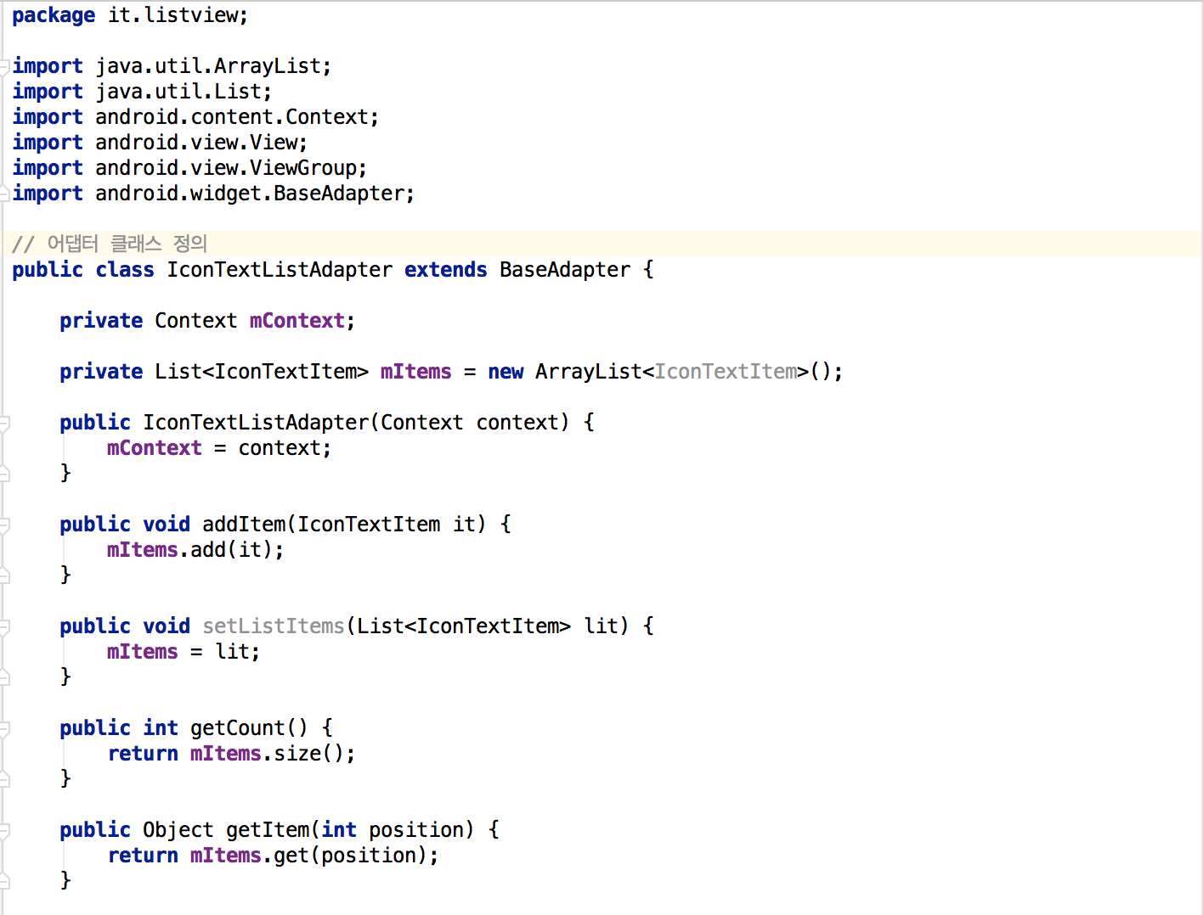
2. ListView
Item Data (IconTextListAdapter.java)
클래스 변경 x, 원하는 개수 늘리고 줄이고 가능
생성자
전체 갯수
전체 갯수 받는 함수

Slide 22
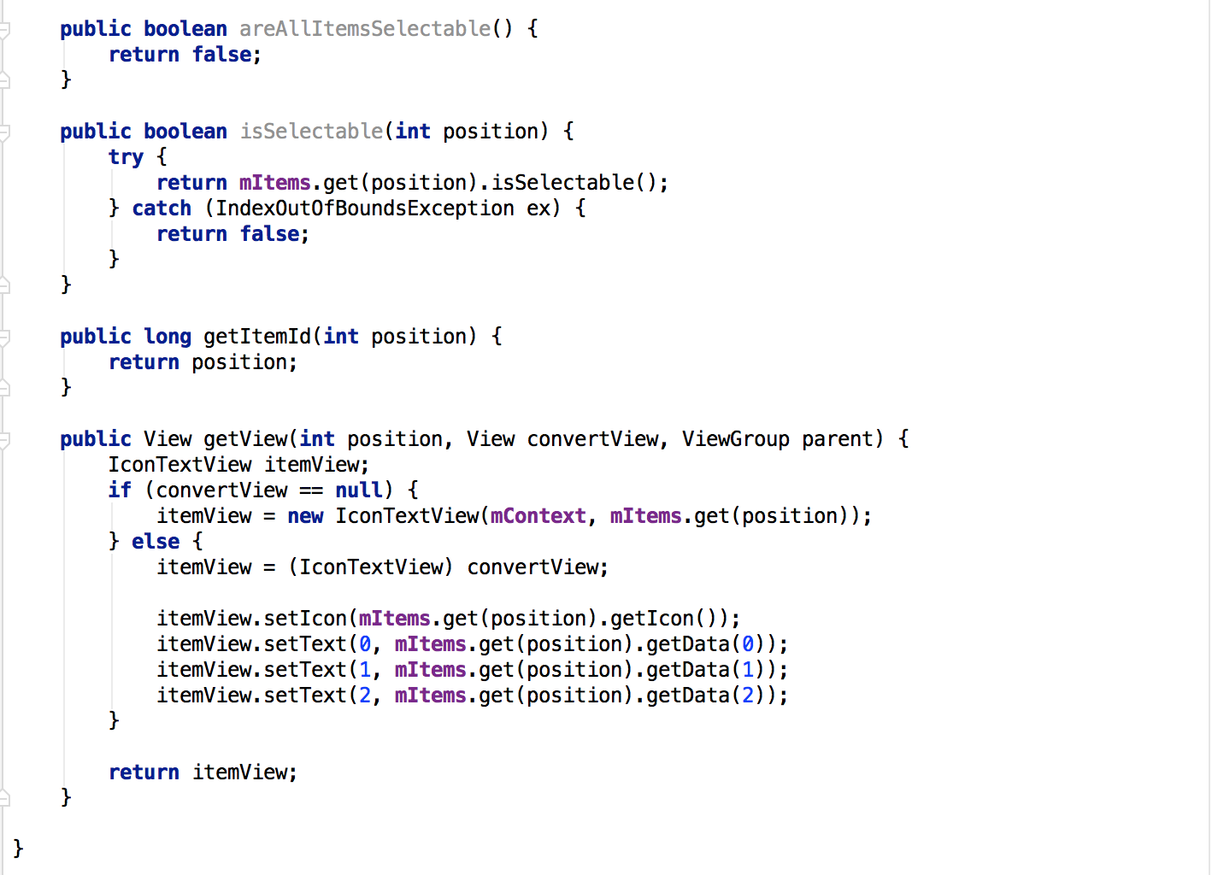
2. ListView
Item Data (IconTextListAdapter.java)
아이템에 표시할 뷰 리턴하는 메소드 정의

Slide 23
2. ListView
Item Data (IconTextListAdapter.java)
package it.listview; import java.util.ArrayList; import java.util.List; import android.content.Context; import android.view.View; import android.view.ViewGroup; import android.widget.BaseAdapter; // 어댑터 클래스 정의 public class IconTextListAdapter extends BaseAdapter { private Context mContext; private List<IconTextItem> mItems = new ArrayList<IconTextItem>(); public IconTextListAdapter(Context context) { mContext = context; } public void addItem(IconTextItem it) { mItems.add(it); } public void setListItems(List<IconTextItem> lit) { mItems = lit; } public int getCount() { return mItems.size(); } public Object getItem(int position) { return mItems.get(position); } public boolean areAllItemsSelectable() { return false; } public boolean isSelectable(int position) { try { return mItems.get(position).isSelectable(); } catch (IndexOutOfBoundsException ex) { return false; } } public long getItemId(int position) { return position; } public View getView(int position, View convertView, ViewGroup parent) { IconTextView itemView; if (convertView == null) { itemView = new IconTextView(mContext, mItems.get(position)); } else { itemView = (IconTextView) convertView; itemView.setIcon(mItems.get(position).getIcon()); itemView.setText(0, mItems.get(position).getData(0)); itemView.setText(1, mItems.get(position).getData(1)); itemView.setText(2, mItems.get(position).getData(2)); } return itemView; } }

Slide 24
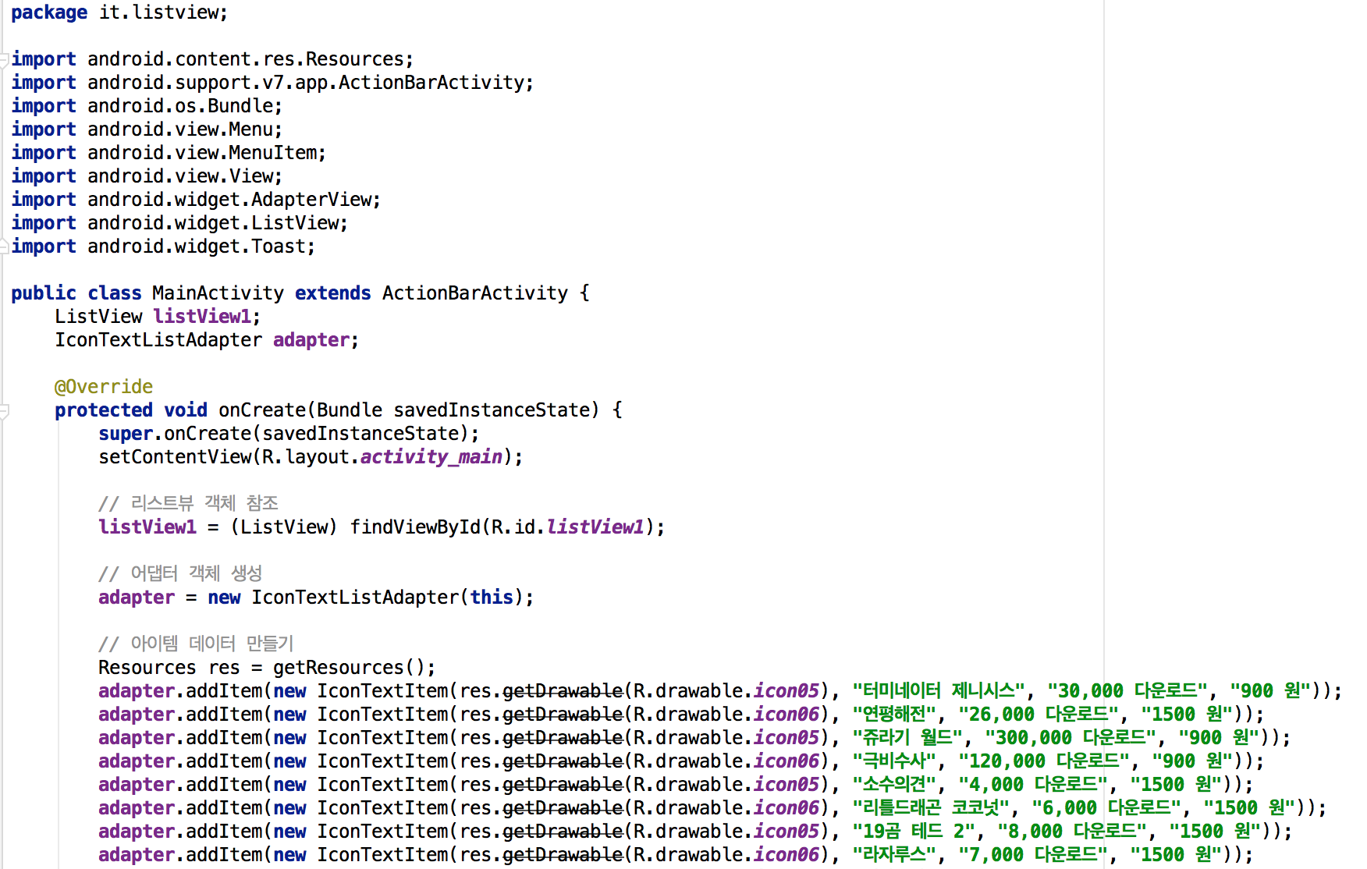
2. ListView
Main(MainActivity.java)
변수 설정
객체 참조
아이템 추가

Slide 25
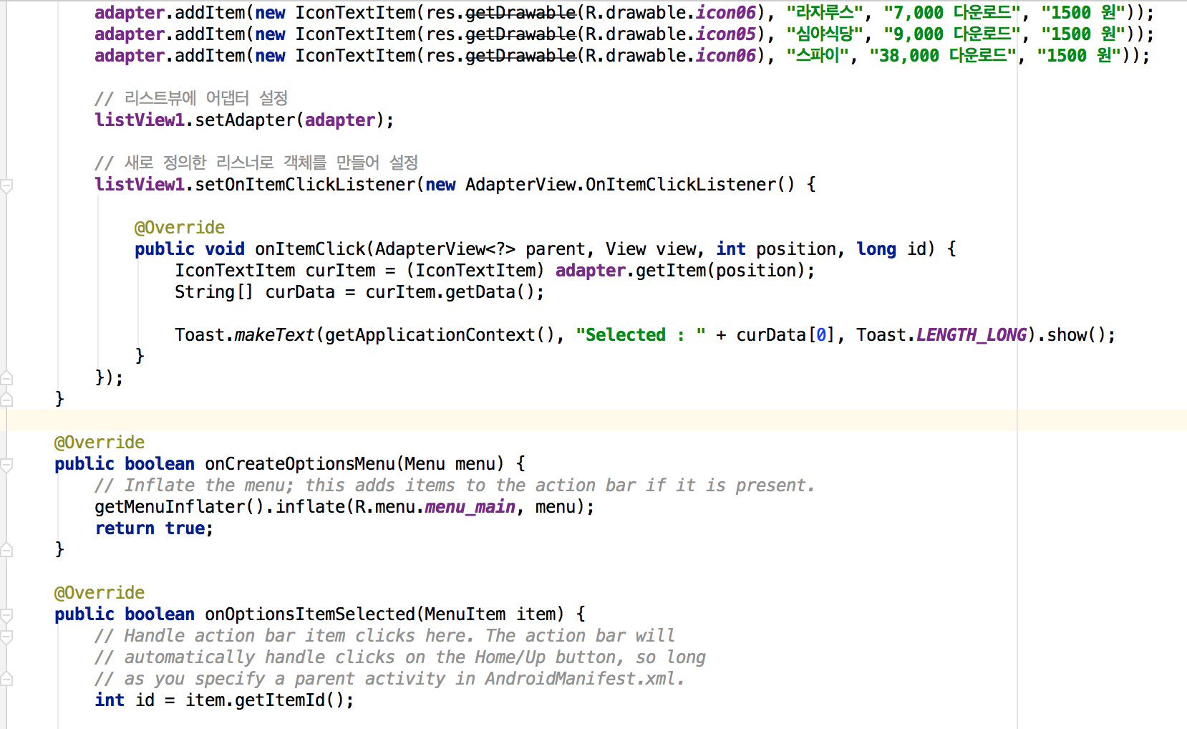
2. ListView
Main(MainActivity.java)

Slide 26
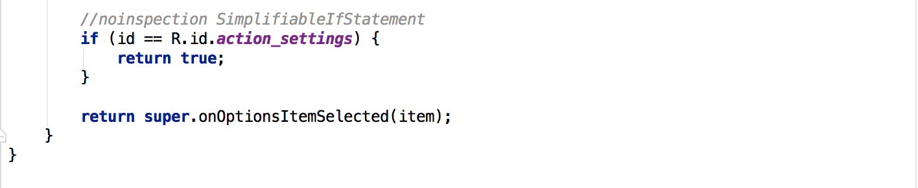
2. ListView
Main(MainActivity.java)

Slide 27
2. ListView
Main(MainActivity.java)
package it.listview; import android.content.res.Resources; import android.support.v7.app.ActionBarActivity; import android.os.Bundle; import android.view.Menu; import android.view.MenuItem; import android.view.View; import android.widget.AdapterView; import android.widget.ListView; import android.widget.Toast; public class MainActivity extends ActionBarActivity { ListView listView1; IconTextListAdapter adapter; @Override protected void onCreate(Bundle savedInstanceState) { super.onCreate(savedInstanceState); setContentView(R.layout.activity_main); // 리스트뷰 객체 참조 listView1 = (ListView) findViewById(R.id.listView1); // 어댑터 객체 생성 adapter = new IconTextListAdapter(this); // 아이템 데이터 만들기 Resources res = getResources(); adapter.addItem(new IconTextItem(res.getDrawable(R.drawable.icon05), "터미네이터 제니시스", "30,000 다운로드", "900 원")); adapter.addItem(new IconTextItem(res.getDrawable(R.drawable.icon06), "연평해전", "26,000 다운로드", "1500 원")); adapter.addItem(new IconTextItem(res.getDrawable(R.drawable.icon05), "쥬라기 월드", "300,000 다운로드", "900 원")); adapter.addItem(new IconTextItem(res.getDrawable(R.drawable.icon06), "극비수사", "120,000 다운로드", "900 원")); adapter.addItem(new IconTextItem(res.getDrawable(R.drawable.icon05), "소수의견", "4,000 다운로드", "1500 원")); adapter.addItem(new IconTextItem(res.getDrawable(R.drawable.icon06), "리틀드래곤 코코넛", "6,000 다운로드", "1500 원")); adapter.addItem(new IconTextItem(res.getDrawable(R.drawable.icon05), "19곰 테드 2", "8,000 다운로드", "1500 원")); adapter.addItem(new IconTextItem(res.getDrawable(R.drawable.icon06), "라자루스", "7,000 다운로드", "1500 원")); adapter.addItem(new IconTextItem(res.getDrawable(R.drawable.icon05), "심야식당", "9,000 다운로드", "1500 원")); adapter.addItem(new IconTextItem(res.getDrawable(R.drawable.icon06), "스파이", "38,000 다운로드", "1500 원")); // 리스트뷰에 어댑터 설정 listView1.setAdapter(adapter); // 새로 정의한 리스너로 객체를 만들어 설정 listView1.setOnItemClickListener(new AdapterView.OnItemClickListener() { @Override public void onItemClick(AdapterView<?> parent, View view, int position, long id) { IconTextItem curItem = (IconTextItem) adapter.getItem(position); String[] curData = curItem.getData(); Toast.makeText(getApplicationContext(), "Selected : " + curData[0], Toast.LENGTH_LONG).show(); } }); } @Override public boolean onCreateOptionsMenu(Menu menu) { // Inflate the menu; this adds items to the action bar if it is present. getMenuInflater().inflate(R.menu.menu_main, menu); return true; } @Override public boolean onOptionsItemSelected(MenuItem item) { // Handle action bar item clicks here. The action bar will // automatically handle clicks on the Home/Up button, so long // as you specify a parent activity in AndroidManifest.xml. int id = item.getItemId(); //noinspection SimplifiableIfStatement if (id == R.id.action_settings) { return true; } return super.onOptionsItemSelected(item); } }

Slide 28
Thank you!

